Slide 1





Prompt Injection Defenses
By: Adrian Lopez and Mallory Sorola

Slide 2


Existing Solutions
Tool Behavior
Implemented Contributions
Overview
Final Demo + Results
Before Vs. After Comparison
Conclusion

Slide 3

Existing Solutions
Rebuff
Vigil
PromptInjection
Combined heuristic based detection with ML-based prompt injection detection
Leveraged complementary strengths to improve overall detection robustness
Reduced reliance on a single detection method
Designed a decision rule that flags prompts if either detector is triggered
Simplified integration between heuristic and ML outputs
Prioritized higher recall to catch more potential attacks
Developed a reusable analyze_prompt function to standardize detection workflow
Implemented batch processing for large prompt datasets
Structured outputs for easy evaluation

Slide 4


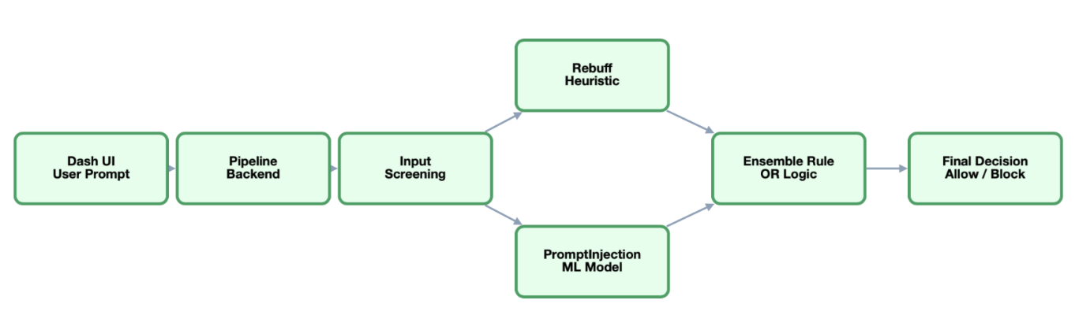
Tool Behavior
Baseline Prompt Injection Scanner
Filters prompts before LLM processing
Prints boolean validity and risk score
Detects common prompt injection patterns
Limited evaluation on predictable prompts

Slide 5
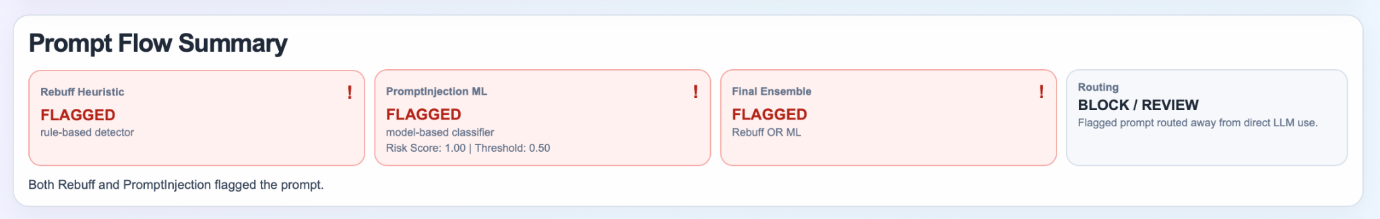
Tool Behavior Cont.
Real-time prompt analysis through multi-layer pipeline
Combines heuristic and ML-based detection
Outputs structured decision path (flag, score, final decision)
Provides explainability for each detection layer

Slide 6
Implemented Contributions
Hybrid Detection System
Decision Logic
Modular Analysis Function
Combined heuristic based detection with ML-based prompt injection detection
Leveraged complementary strengths to improve overall detection robustness
Reduced reliance on a single detection method
Designed a decision rule that flags prompts if either detector is triggered
Simplified integration between heuristic and ML outputs
Prioritized higher recall to catch more potential attacks
Developed a reusable analyze_prompt function to standardize detection workflow
Implemented batch processing for large prompt datasets
Structured outputs for easy evaluation

Slide 7

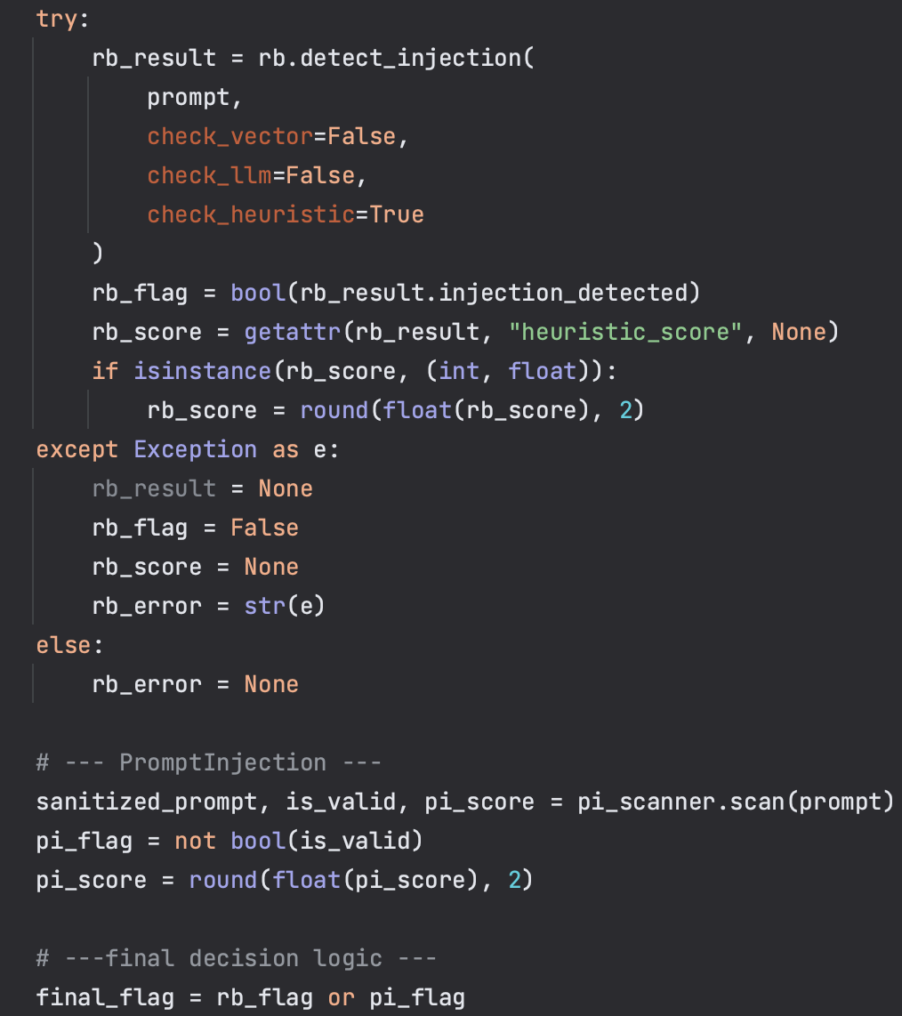
Demo Code
Integrates Rebuff with ML prompt injection classifier
Implements a unified analysis function that process prompts through both detectors
Uses decision logic to generate a final safety verdict
Built to be easily implemented into LLM pipelines as a pre-processing filter
PAGE 5

Slide 8


Slide 9
PromptInjection
Rebuff + PromptInjection
Single detection method
Limited dataset evaluation
No structured pipeline
Minimal explainability
More vulnerable to complex prompts
Hybrid detection (Heuristic + ML)
Evaluated on 1,000 diverse prompts
Scalable batch processing pipeline
Structured outputs (scores, flags, decisions)
Improved robustness and coverage

Slide 10
Conclusion
Our system combines heuristic and machine learning detection into a unified prompt injection guardrail that:
Improves detection across diverse prompt types
Handles ambiguous and paraphrased attacks
Scales to large prompt datasets through batch processing
Provides structured, explainable decision outputs
This demonstrates the effectiveness of hybrid detection for securing real-world LLM systems.

Slide 11
Thank You!

